Slide 1
Arrays
In this chapter, we will discuss arrays.
An array is a user-defined data type that stores related information together.
All the information stored in an array belongs to the same data type.
So, in this chapter, we will learn how arrays are defined, declared, initialized, and accessed.
We will also discuss the different operations that can be performed on array elements and the different types of arrays such as two-dimensional arrays, multi-dimensional arrays, and sparse matrices.
1

Slide 2
INTRODUCTION
We will explain the concept of arrays using an analogy.
Consider a situation in which we have 20 students in a class and we have been asked to write a program that reads and prints the marks of all the 20 students.
In this program, we will need 20 integer variables with different names, as shown in Fig. 3.1.

Slide 3
DECLARATION OF ARRAYS
We have already seen that every variable must be declared before it is used.
The same concept holds true for array variables.
An array must be declared before being used.
Declaring an array means specifying the following:
Data type—the kind of values it can store, for example, int, char, float, double.
Name—to identify the array.
Size—the maximum number of values that the array can hold.
Arrays are declared using the following syntax:
type name[size];
The type can be either int, float, double, char, or any other valid data type.
The number within brackets indicates the size of the array, i.e., the maximum number of elements that can be stored in the array.
For example, if we write,
int marks[10];
then the statement declares marks to be an array containing 10 elements.
In C, the array index starts from zero.
The first element will be stored in marks[0], second element in marks[1], and so on.
Therefore, the last element, that is the 10th element, will be stored in marks[9].
Note that 0, 1, 2, 3 written within square brackets are the subscripts.
In the memory, the array will be stored as shown in Fig. 3.2.

Slide 4
ACCESSING THE ELEMENTS OF AN ARRAY
Storing related data items in a single array enables the programmers to develop concise and efficient programs.
But there is no single function that can operate on all the elements of an array.
To access all the elements, we must use a loop.
That is, we can access all the elements of an array by varying the value of the subscript into the array.

Slide 5
STORING Values IN ARRAYS
When we declare an array, we are just allocating space for its elements; no values are stored in the array.
There are three ways to store values in an array.
First, to initialize the array elements during declaration; second, to input values for individual elements from the keyboard; third, to assign values to individual elements.
This is shown in Fig. 3.6.

Slide 6
Initializing Arrays during Declaration
The elements of an array can be initialized at the time of declaration, just as any other variable.
When an array is initialized, we need to provide a value for every element in the array.
Arrays are initialized by writing,
type array_name[size]={list of values};
Note that the values are written within curly brackets and every value is separated by a comma.
It is a compiler error to specify more values than there are elements in the array.
When we write,
int marks[5]={90, 82, 78, 95, 88};
An array with the name marks is declared that has enough space to store five elements.
The first element, that is, marks[0] is assigned value 90.
Similarly, the second element of the array, that is marks[1], is assigned 82, and so on.
This is shown in Fig. 3.7.
While initializing the array at the time of declaration, the programmer may omit the size of the array.
For example,
int marks[]= {98, 97, 90};
The above statement is absolutely legal.
Here, the compiler will allocate enough space for all the initialized elements.
Note that if the number of values provided is less than the number of elements in the array, the un-assigned elements are filled with zeros.
Figure 3.8 shows the initialization of arrays.

Slide 7
Inputting Values from the Keyboard
An array can be initialized by inputting values from the keyboard.
In this method, a while/do–while or a for loop is executed to input the value for each element of the array.
For example, look at the code shown in Fig. 3.9.
In the code, we start at the index i at 0 and input the value for the first element of the array.
Since the array has 10 elements, we must input values for elements whose index varies from 0 to 9.

Slide 8
Assigning Values to Individual Elements
The third way is to assign values to individual elements of the array by using the assignment operator.
Any value that evaluates to the data type as that of the array can be assigned to the individual array element.
A simple assignment statement can be written as
marks[3] = 100;
Here, 100 is assigned to the fourth element of the array which is specified as marks[3].
Note that we cannot assign one array to another array, even if the two arrays have the same type and size.
To copy an array, you must copy the value of every element of the first array into the elements of the second array.
Figure 3.10 illustrates the code to copy an array.
In Fig. 3.10, the loop accesses each element of the first array and simultaneously assigns its value to the corresponding element of the second array.
The index value i is incremented to access the next element in succession.
Therefore, when this code is executed, arr2[0] = arr1[0], arr2[1] = arr1[1], arr2[2] = arr1[2], and so on.
We can also use a loop to assign a pattern of values to the array elements.
For example, if we want to fill an array with even integers (starting from 0), then we will write the code as shown in Fig. 3.11.
In the code, we assign to each element a value equal to twice of its index, where the index starts from 0.
So after executing this code, we will have arr[0] = 0, arr[1] = 2, arr[2] = 4, and so on.

Slide 9
OPERATIONS ON ARRAYS
There are a number of operations that can be preformed on arrays.
These operations include:
Traversing an array
Inserting an element in an array
Searching an element in an array
Deleting an element from an array
Merging two arrays
Sorting an array in ascending or descending order

Slide 10
Traversing an Array
Traversing an array means accessing each and every element of the array for a specific purpose.
Traversing the data elements of an array A can include printing every element, counting the total number of elements, or performing any process on these elements.
Since, array is a linear data structure (because all its elements form a sequence), traversing its elements is very simple and straightforward.
The algorithm for array traversal is given in Fig. 3.12.
Step 1: [INITIALIZATION] SET I = lower_bound
Step 2: Repeat Steps 3 to 4 while I <= upper_bound
Step 3: Apply Process to A[I]
Step 4: SET I = I + 1
[END OF LOOP]
Step 5: EXIT
Figure 3.12 Algorithm for array traversal
In Step 1, we initialize the index to the lower bound of the array.
In Step 2, a while loop is executed.
Step 3 processes the individual array element as specified by the array name and index value.
Step 4 increments the index value so that the next array element could be processed.
The while loop in Step 2 is executed until all the elements in the array are processed, i.e., until I is less than or equal to the upper bound of the array.

Slide 11
Inserting an Element in an Array
If an element has to be inserted at the end of an existing array, then the task of insertion is quite simple.
We just have to add 1 to the upper_ bound and assign the value.
Here, we assume that the memory space allocated for the array is still available.
For example, if an array is declared to contain 10 elements, but currently it has only 8 elements, then obviously there is space to accommodate two more elements.
But if it already has 10 elements, then we will not be able to add another element to it.
Figure 3.13 shows an algorithm to insert a new element to the end of an array.
In Step 1, we increment the value of the upper_bound.
In Step 2, the new value is stored at the position pointed by the upper_bound.
For example, let us assume an array has been declared as
int marks[60];
The array is declared to store the marks of all the students in a class.
Now, suppose there are 54 students and a new student comes and is asked to take the same test.
The marks of this new student would be stored in marks[55].
Assuming that the student secured 68 marks, we will assign the value as
marks[55] = 68;
However, if we have to insert an element in the middle of the array, then this is not a trivial task.
On an average, we might have to move as much as half of the elements from their positions in order to accommodate space for the new element.
For example, consider an array whose elements are arranged in ascending order.
Now, if a new element has to be added, it will have to be added probably somewhere in the middle of the array.
To do this, we must first find the location where the new element will be inserted and then move all the elements (that have a value greater than that of the new element) one position to the right so that space can be created to store the new value.

Slide 12
Algorithm to Insert an Element in the Middle of an Array
The algorithm INSERT will be declared as INSERT (A, N, POS, VAL).
The arguments are
A, the array in which the element has to be inserted
N, the number of elements in the array
POS, the position at which the element has to be inserted
VAL, the value that has to be inserted
In the algorithm given in Fig. 3.14, in Step 1, we first initialize I with the total number of elements in the array.
In Step 2, a while loop is executed which will move all the elements having an index greater than POS one position towards right to create space for the new element.
In Step 5, we increment the total number of elements in the array by 1 and finally in Step 6, the new value is inserted at the desired position.

Slide 13
Algorithm to Insert an Element in the Middle of an Array

Slide 14
Deleting an Element from an Array
Deleting an element from an array means removing a data element from an already existing array.
If the element has to be deleted from the end of the existing array, then the task of deletion is quite simple.
We just have to subtract 1 from the upper_bound.
Figure 3.15 shows an algorithm to delete an element from the end of an array.
Step 1: SET upper_bound = upper_bound - 1
Step 2: EXIT
Figure 3.15 Algorithm to delete the last element of an array
For example, if we have an array that is declared as
int marks[60];
The array is declared to store the marks of all the students in the class.
Now, suppose there are 54 students and the student with roll number 54 leaves the course.
The score of this student was stored in marks[54].
We just have to decrement the upper_bound.
Subtracting 1 from the upper_bound will indicate that there are 53 valid data in the array.
However, if we have to delete an element from the middle of an array, then it is not a trivial task.
On an average, we might have to move as much as half of the elements from their positions in order to occupy the space of the deleted element.
For example, consider an array whose elements are arranged in ascending order.
Now, suppose an element has to be deleted, probably from somewhere in the middle of the array.
To do this, we must first find the location from where the element has to be deleted and then move all the elements (having a value greater than that of the element) one position towards left so that the space vacated by the deleted element can be occupied by rest of the elements.

Slide 15
Algorithm to delete an element from the middle of an array
The algorithm DELETE will be declared as DELETE(A, N, POS).
The arguments are:
A, the array from which the element has to be deleted
N, the number of elements in the array
POS, the position from which the element has to be deleted
Figure 3.16 shows the algorithm in which we first initialize I with the position from which the element has to be deleted.
In Step 2, a while loop is executed which will move all the elements having an index greater than POS one space towards left to occupy the space vacated by the deleted element.
When we say that we are deleting an element, actually we are overwriting the element with the value of its successive element.
In Step 5, we decrement the total number of elements in the array by 1.
Now, let us visualize this algorithm by taking an example given in Fig. 3.17.
Calling DELETE (Data, 6, 2) will lead to the following processing in the array.

Slide 17
Merging Two Arrays
Merging two arrays in a third array means first copying the contents of the first array into the third array and then copying the contents of the second array into the third array.
Hence, the merged array contains the contents of the first array followed by the contents of the second array.
If the arrays are unsorted, then merging the arrays is very simple, as one just needs to copy the contents of one array into another.
But merging is not a trivial task when the two arrays are sorted and the merged array also needs to be sorted.
Let us first discuss the merge operation on unsorted arrays.
This operation is shown in Fig 3.18.

Slide 21
FUNCTIONS

Slide 22
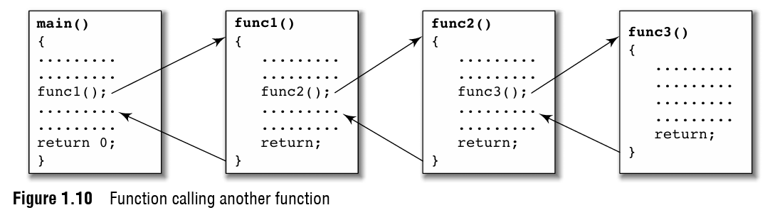

Slide 23
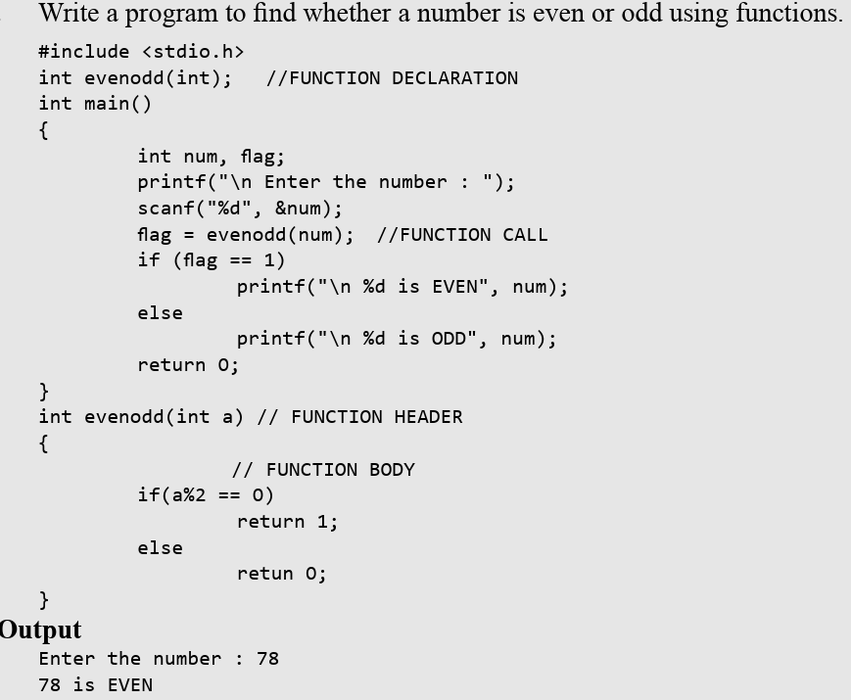

Slide 24
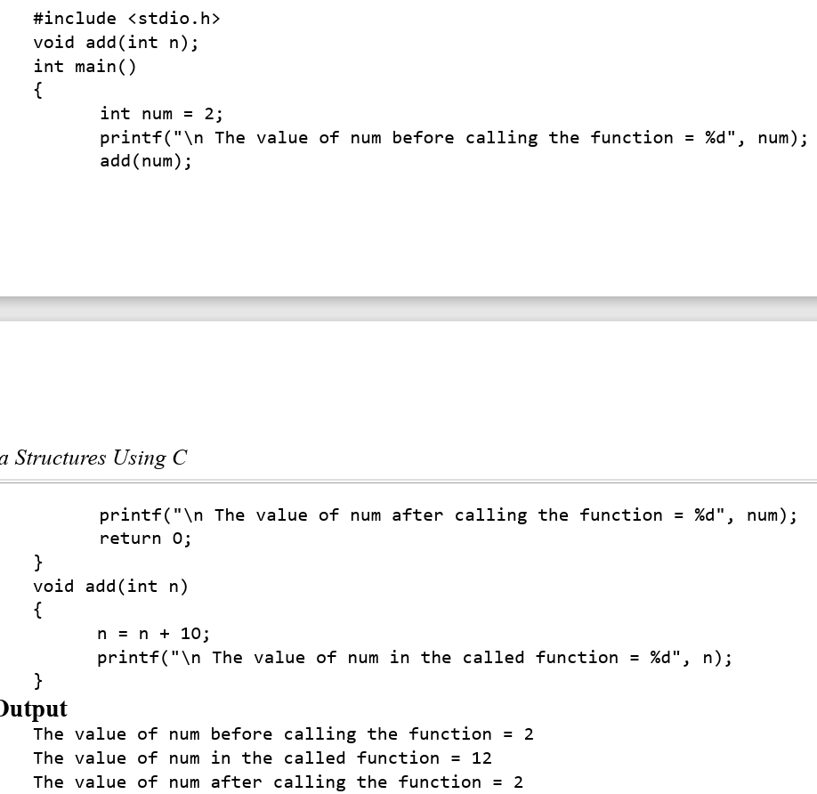
Call by Value

Slide 25
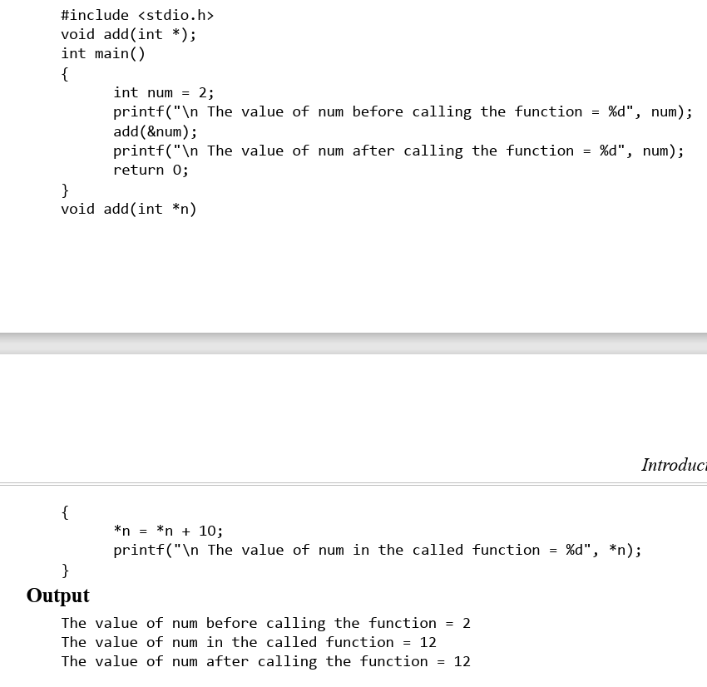
Call by Reference

Slide 26
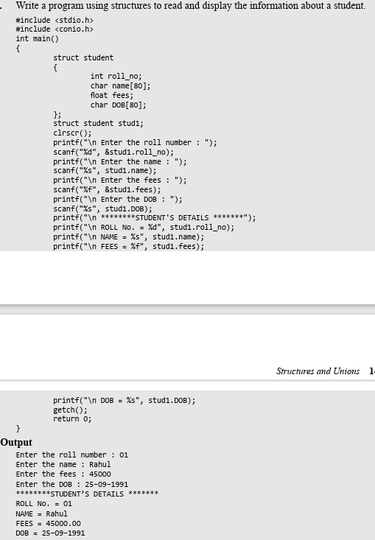
STRUCTURES

